Slide 1
Project 2 Overview: Simplified Page Rank

Slide 2
Page Rank Algorithm Overview
Back in the 1990s, Google co-founders Larry Page and Sergey Brin wondered how can we trust information on the Internet. Why are some websites more “important” than others?
In answering this question, the Page Rank algorithm was born!
Page Rank is an algorithm used to rank pages on the Internet to demonstrate their relative importance.
Once we represent webpages on the Internet in an adjacency list graph, we will run the Page Rank algorithm on these pages to determine their importance.

Slide 3
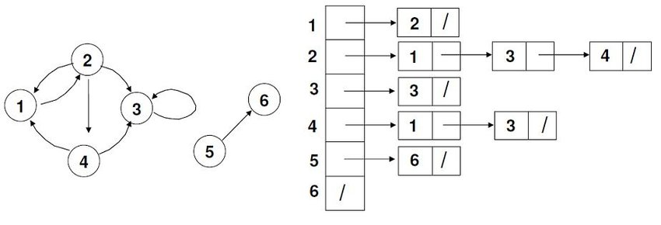
Adjacency Lists
Conceptually, adjacency lists are a representation of graphs as a collection of lists, where each vertex has a list of its neighbors.
This is an example of a directed graph, where each node has an entry in the collection on the right. Associated with the node is a list of all nodes directly reachable from that node.
For this project, you will need to store webpages as nodes in a directed graph.

Slide 4
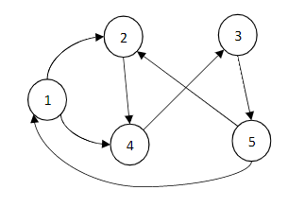
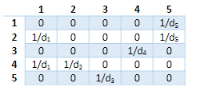
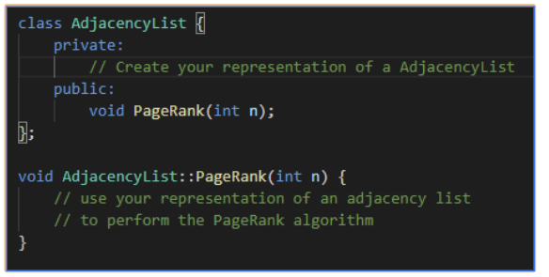
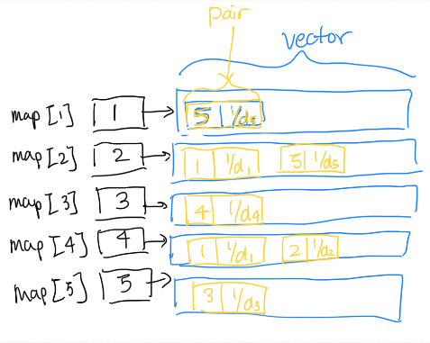

Adjacency Lists C++
You will be building an adjacency list as your primary structure to hold the webpages
One recommended way to store the pages is a map, where strings are mapped to vector of pairs
Definitions:
= outdegree of URL x
Note that 1,2,...,5 all correspond to URLs

Slide 5

How are ranks calculated?
In our graph, each webpage node has incoming and outgoing nodes, as the pages are represented in a directed graph.
Each node also has a rank, r, which is split equally among the node’s outgoing links.
Page Rank Formula:
Notes:
Each node has a rank ‘r’. A node’s rank influences the ranks of outgoing links (so like, nodes that are link TO by other nodes are important)

Slide 6
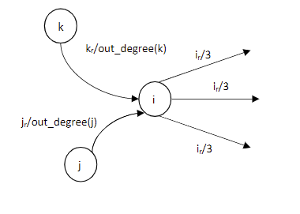
How are ranks calculated?
Rank is based on the importance of incoming nodes (indegrees)
Example:
In the figure, rank of node i is
rank(i) = rank(k)/out_degree(k) + rank(j)/out_degree(j)
Thus, the rank is based on the indegree (the number of
nodes pointing to it).

Slide 7
How are ranks calculated?
Rank is based on the importance of incoming nodes (indegrees)
Example:
In the figure, rank of node i is
rank(i) = rank(k)/out_degree(k) + rank(j)/out_degree(j)
Thus, the rank is based on the indegree (the number of
nodes pointing to it).

Slide 8
How are ranks calculated?
Rank is based on the importance of incoming nodes (indegrees)
Example:
Take Node 2 in the map:
rank(2) = [Node 1’s contribution] + [Node 5’s contribution]

Slide 9
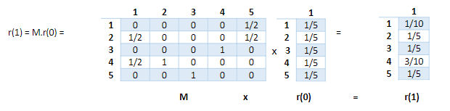
How are ranks calculated?
SIMPLIFICATION: MATRIX MULTIPLICATION
r(x) = M x r(x-1)
r is the (n x 1) matrix that holds the PageRanks for each URL
M is the (n x n) matrix,
M(i,j) = (1/d_j)
You will have to implement this via an Adjacency List (NOT a Matrix)
Where:
r(0) = [⅕, ⅕, ⅕, ⅕,⅕ ] for this example
For each power iteration, perform a matrix multiplication to get the PageRank of power x
r(1) = M x r(0)
Notes:
Initialize r(0), each initial pagerank is equal to 1/n

Slide 10
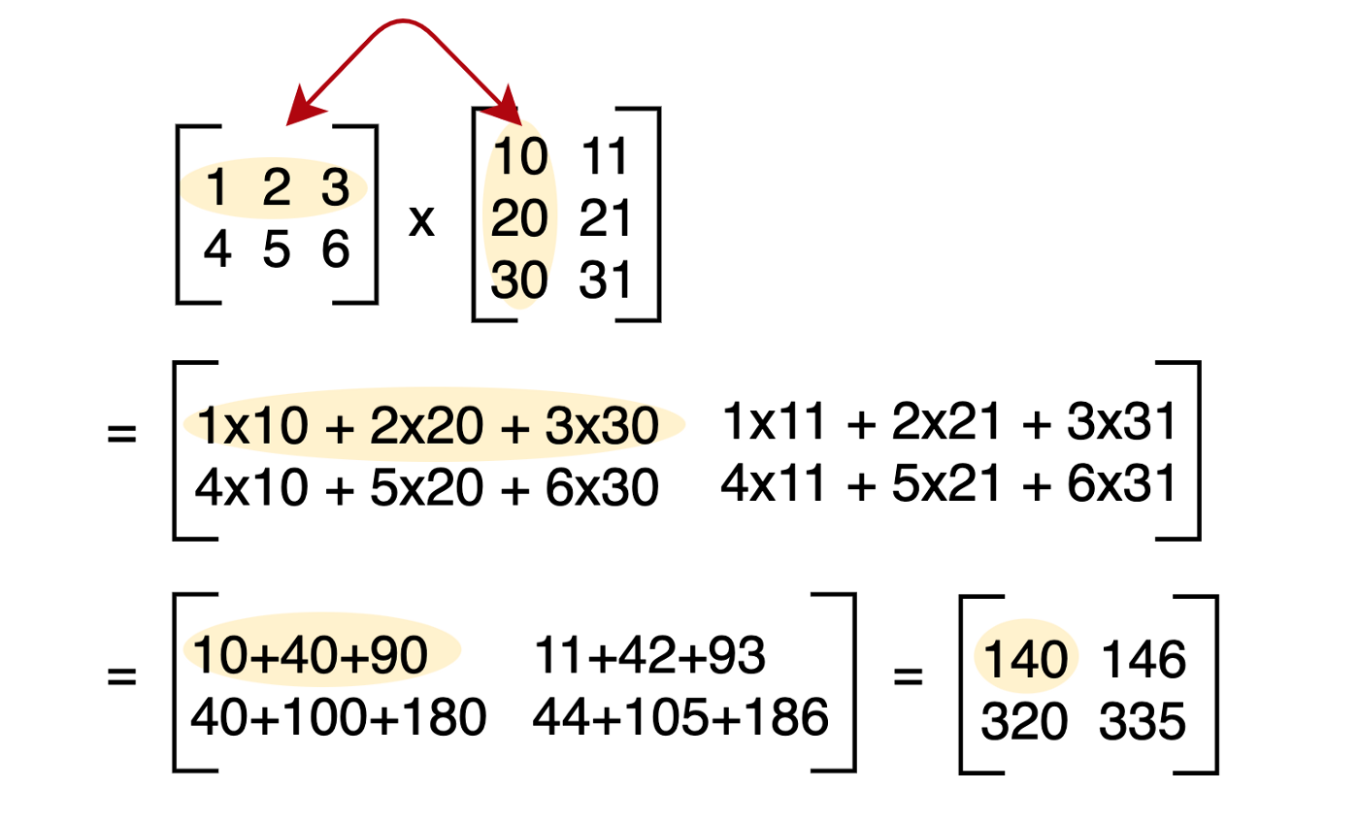
Matrix Multiplication Example
Notes:
Initialize r(0), each initial pagerank is equal to 1/n

Slide 11
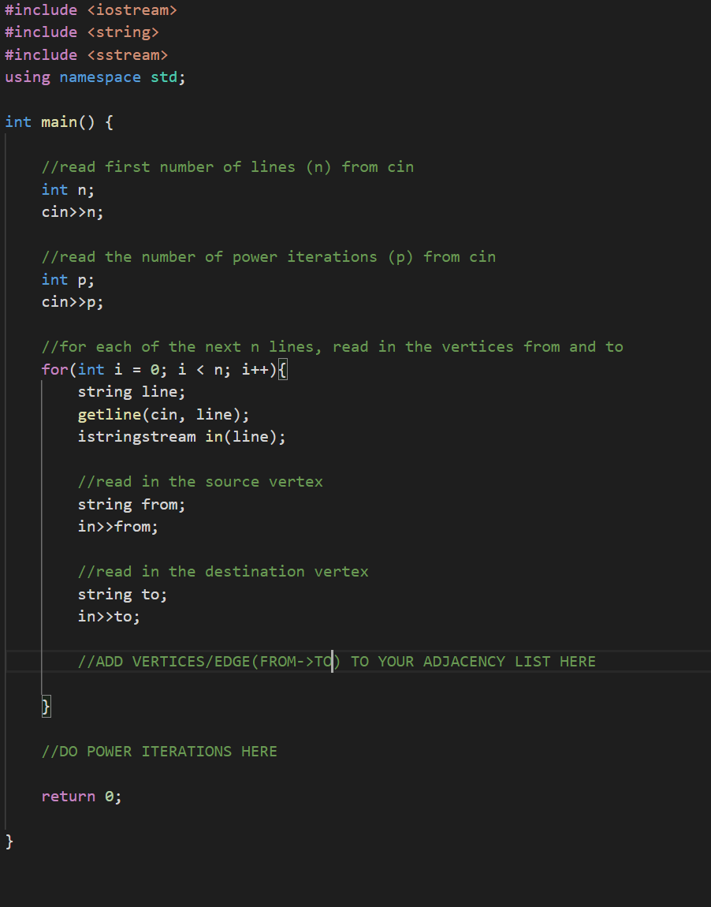
Main - Parsing Input
We can use cin to read in the number of lines and power iterations.
And then we can use getline and stringstream to read each line and split it by spaces.
https://cplusplus.com/reference/string/string/getline/
https://cplusplus.com/reference/sstream/

Slide 12
Recommend Outline
Graph Implementation
You can use STL containers
Must use an Adjacency List representation
Graph should store weights (or contributing ranks) of incoming nodes
Page Rank Algorithm
Build your algorithm
Take into account power iterations
Main for Parsing Inputs
Write program to read in your Adjacency List of webpages

